Slide 1
Summary Generation Using NLP Techniques
Team : -
Sweta Gupta
Yash Jobalia
Isheet Shetty
Project Guide: Prof. Anagha Patil

Slide 2



Team Members
Sweta Gupta
Yash Jobalia
Isheet Shetty

Slide 3
Problem Statement
In the modern day, time is not only considered as valuable but is also sometimes regarded as the most important aspect because once spent it cannot be taken back.
Moreover no one has the luxury of spending their precious time on reading reports which are more than a few pages long just of the regular day to day meeting or a general conversation.
Hence in order to save your valuable time the meeting summarizer can summarize the entire meeting into a few paragraphs and also highlight the entire gist of the content in a few lines.
The project’s purpose is to learn about natural language processing concepts and construct a text summary machine learning tool that only incorporates the most important information from the material.

Slide 4
Abstract
The world is plummeting by the increasing of the amount of data, with such a bombardment of data wandering aimlessly in a high-tech real-time virtual universe, it appears necessary to summarize the extra large texts and serve on a target compendium that can cogently deliver the intended messages.
Therefore, summary generation is the need of the hour.
Amongst the various NLP summarization systems and techniques which exists in the world, we have focused on the two broad methods of summarization which are extractive text summarization as well as the abstractive text summarization.

Slide 5
Introduction
The motive is to use the huge amount of data provided, abstract the required information and try to highlight emphasize on the necessary knowledge that it contains.
Text summarization is bifurcated into categories as follows :
• Extractive Summarization
• Abstractive Summarization.
Extractive text summarization is to handpick must-have and imperative sentence from the text.
Abstractive summarization learns the main concept of the long-drawn-out document and meaning of the same document or text.

Slide 6
Literature Survey

Slide 7
Research Papers
Extractive summarization using sentence ranking
Extractive text summarization by feature based sentence extraction using rulebased
Study on abstractive text summarization techniques
Automatic text summarization using Gensim word2vec and K-means algorithm
Development of GUI for text to speech recognition using NLP
StreamLit web application analysis
1
2
3
4
5
6
7
8
9
10
11
12
Analyzing fuzzy based approach for extractive text summarization
NLP based latent semantic analysis for legal text summarization
Word sequence models for single text summarization
A survey on automatic text summarization.
Abstractive summarization of meeting conversations.
Multilingual support analysis

Slide 8
Research Process
First part
Research about Extractive Summarization.
Analysis on extractive summarization by extracting upmost weighted frequency sentences.
Rule-based approach as well as latent semantic analysis.

Slide 9
Research Process
Second
part
Focuses on abstractive summarization.
The goal of this part is to highlight and examine current models for abstractive text summarization using tf-idf scores.

Slide 10
Research Process
Third part
Enhancing the project single and multi-document summarization.
Speech to text and text to speech conversion analysis.
Language support.

Slide 11
Methodology
Input
User can select any one of the methods for input: Audio or Document or Text
Using Python Speech Recognition/ Google Speech To Text API
Document
Text Extraction
Audio
Text
Additional Feature
Further summary can be converted to speech & language support
Summarized Text

Slide 12
Implementation

Slide 13
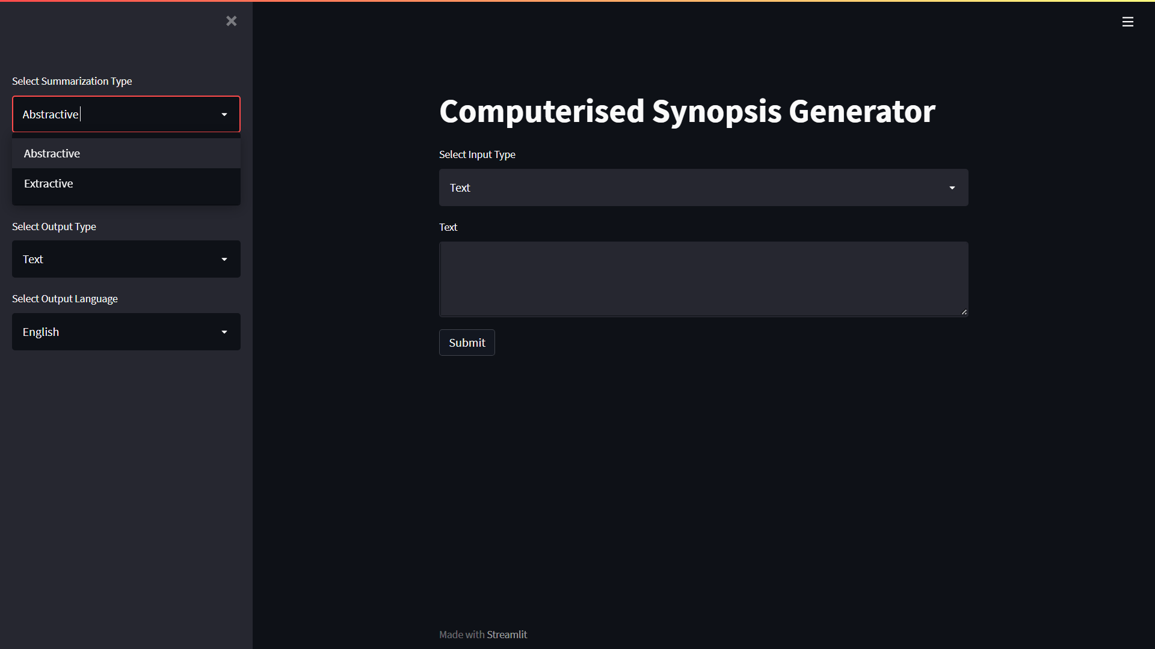
Summary Types

Slide 14
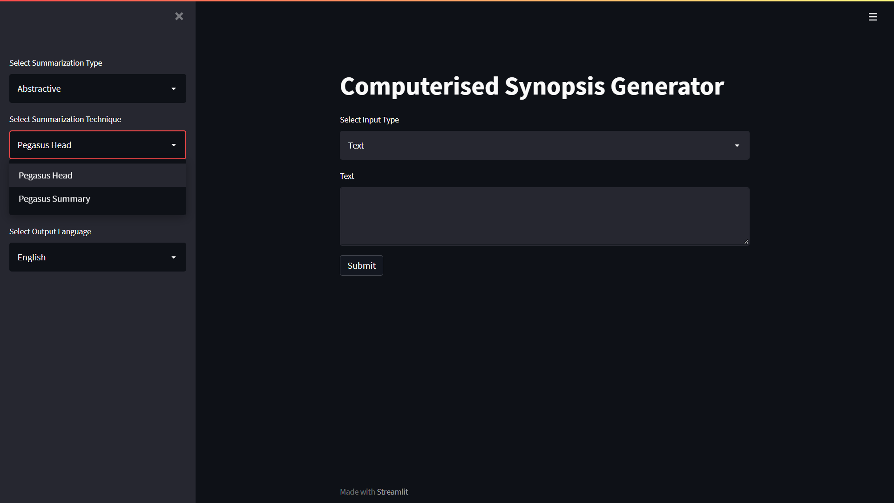
Abstractive Pegasus Summarization Types

Slide 15
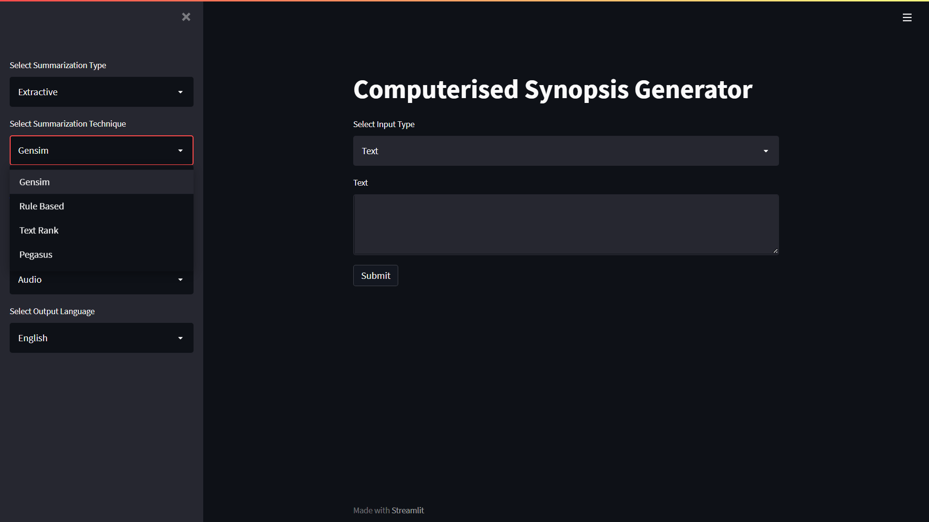
Extractive Summarization Types

Slide 16
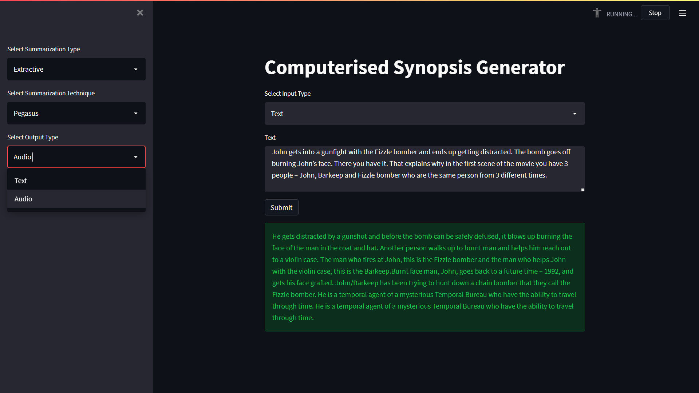
Output Types Supported

Slide 17
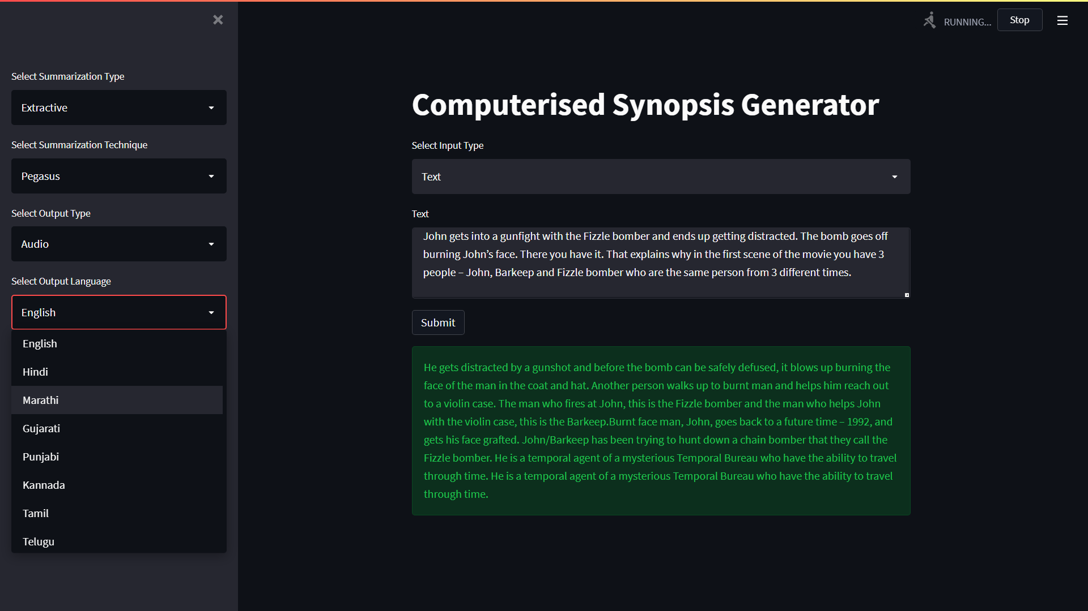
Output Languages Supported

Slide 18
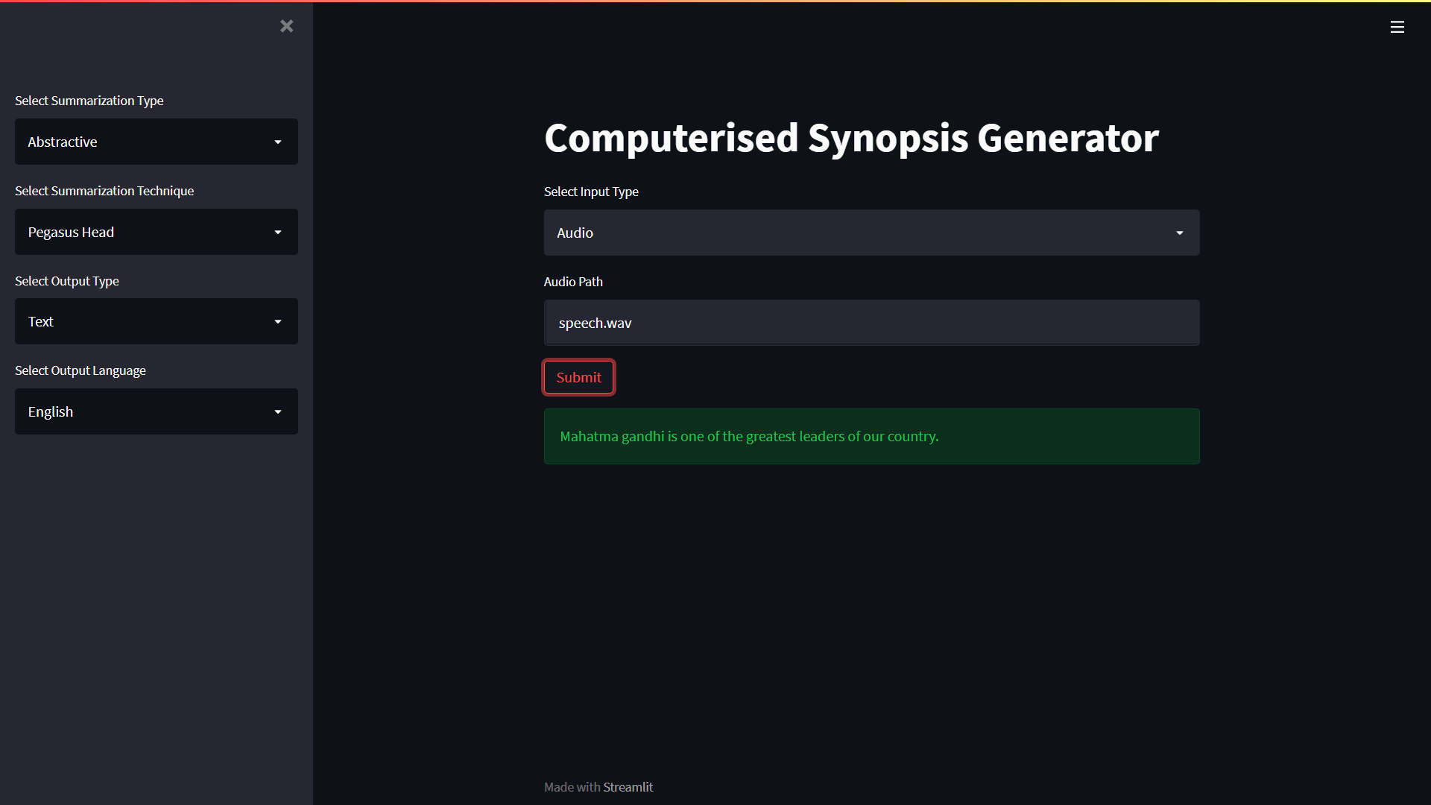
Abstractive Using Pegasus Head

Slide 19
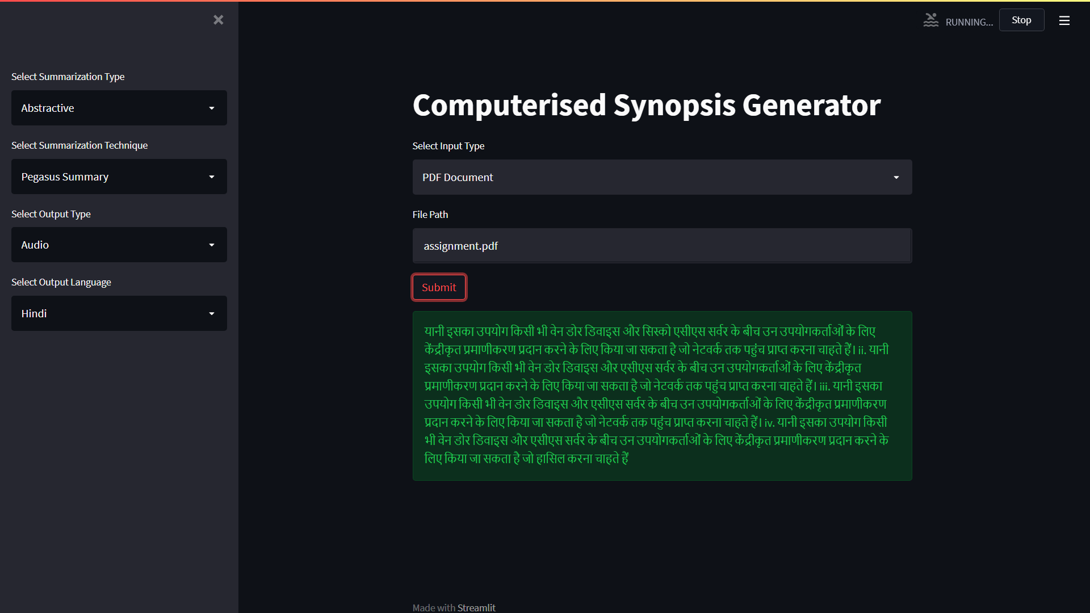
Abstractive Using Pegasus Summary

Slide 20
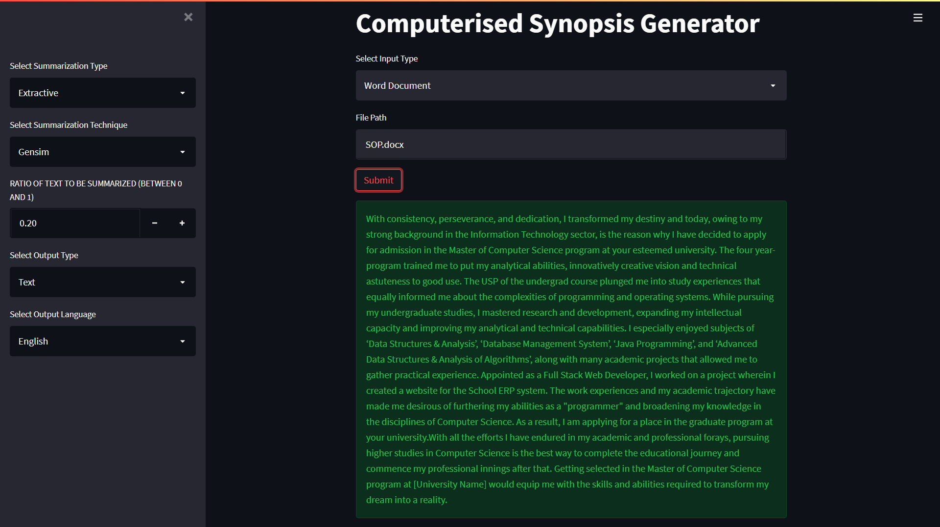
Extractive Gensim in English

Slide 21
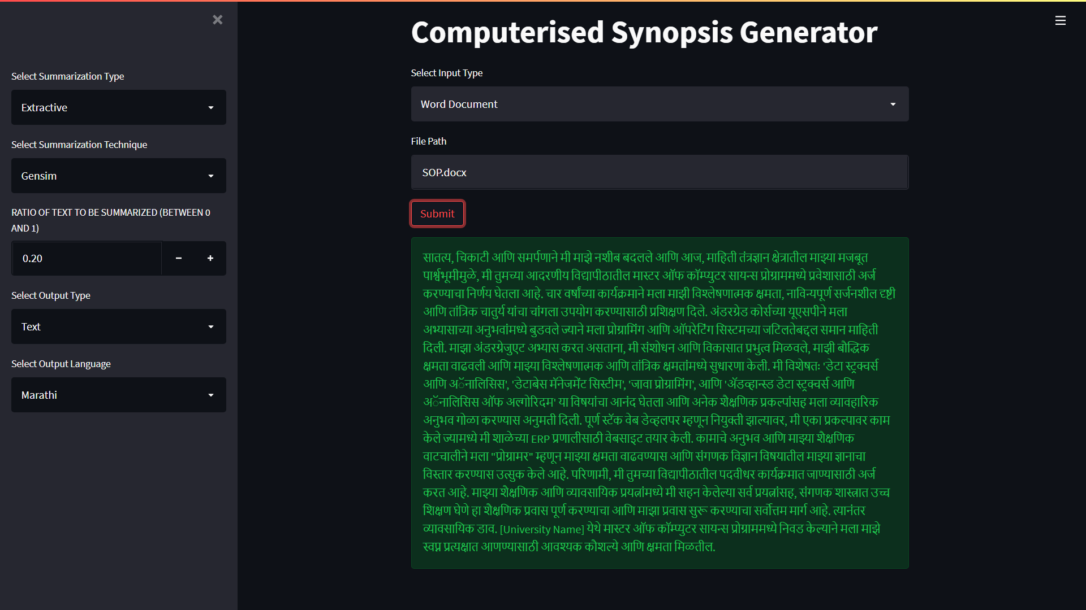
Extractive Gensim in Marathi

Slide 22
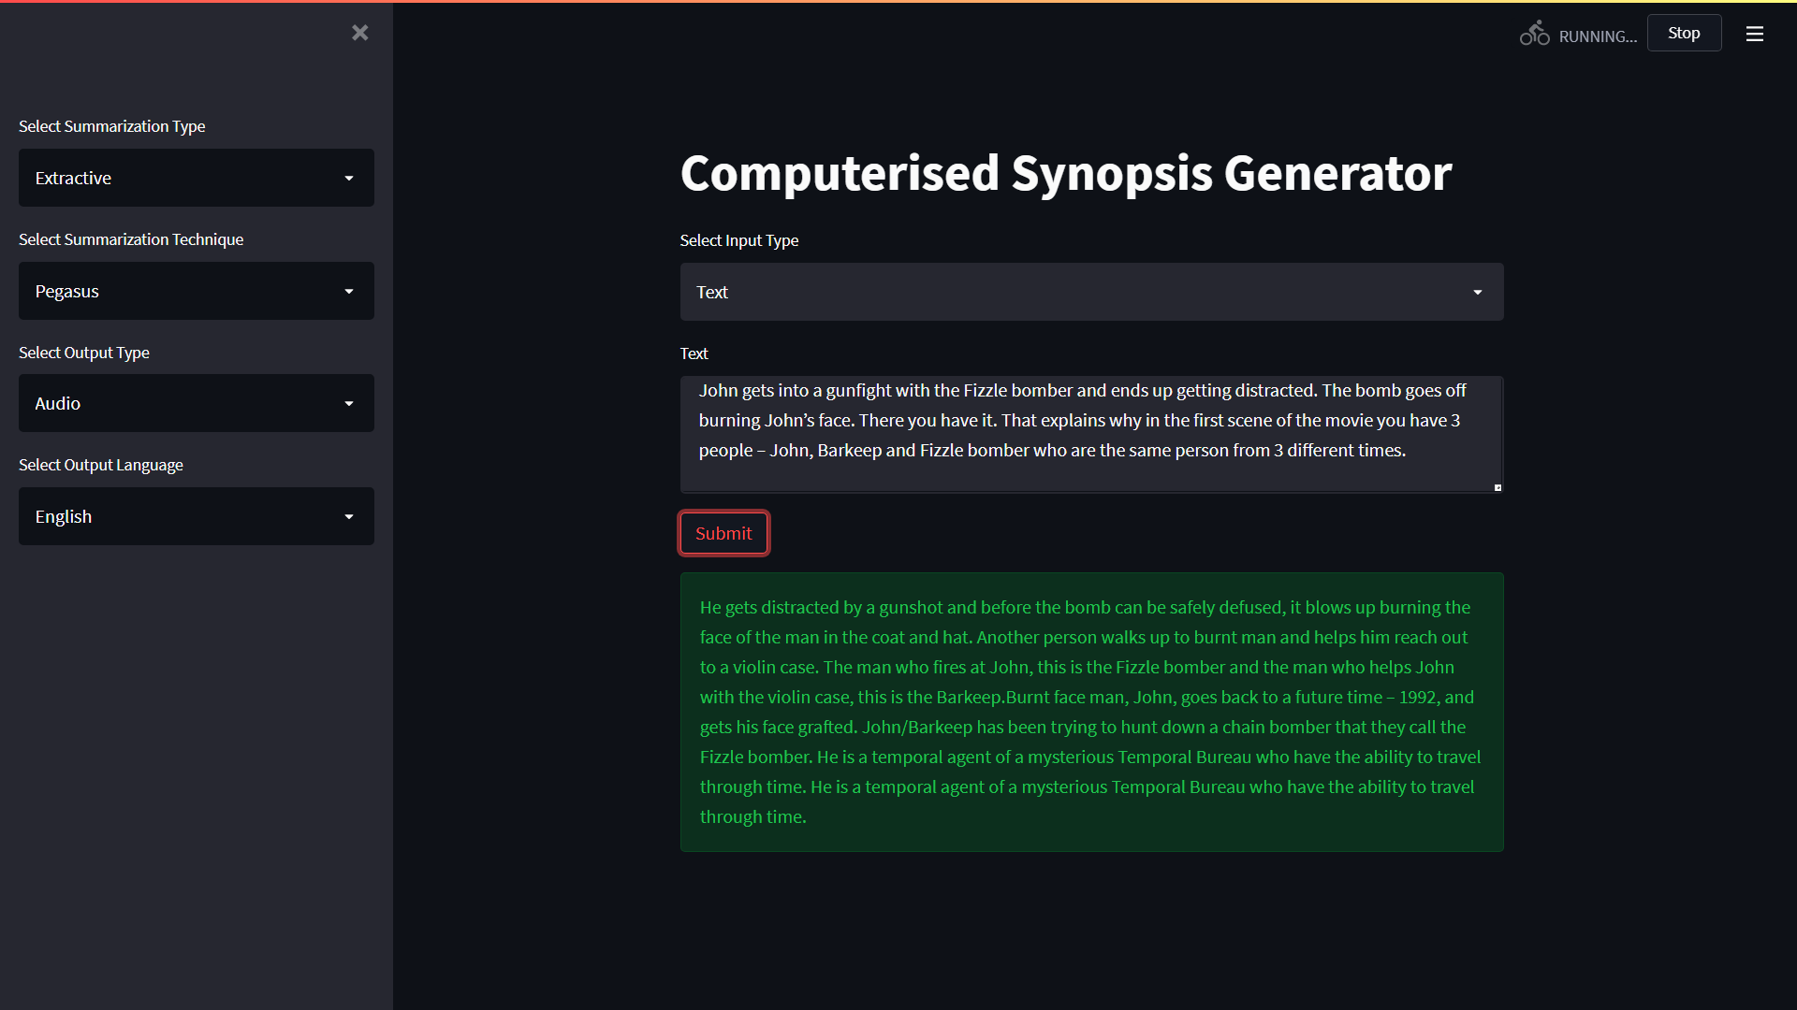
Extractive Using Pegasus (Audio)

Slide 23
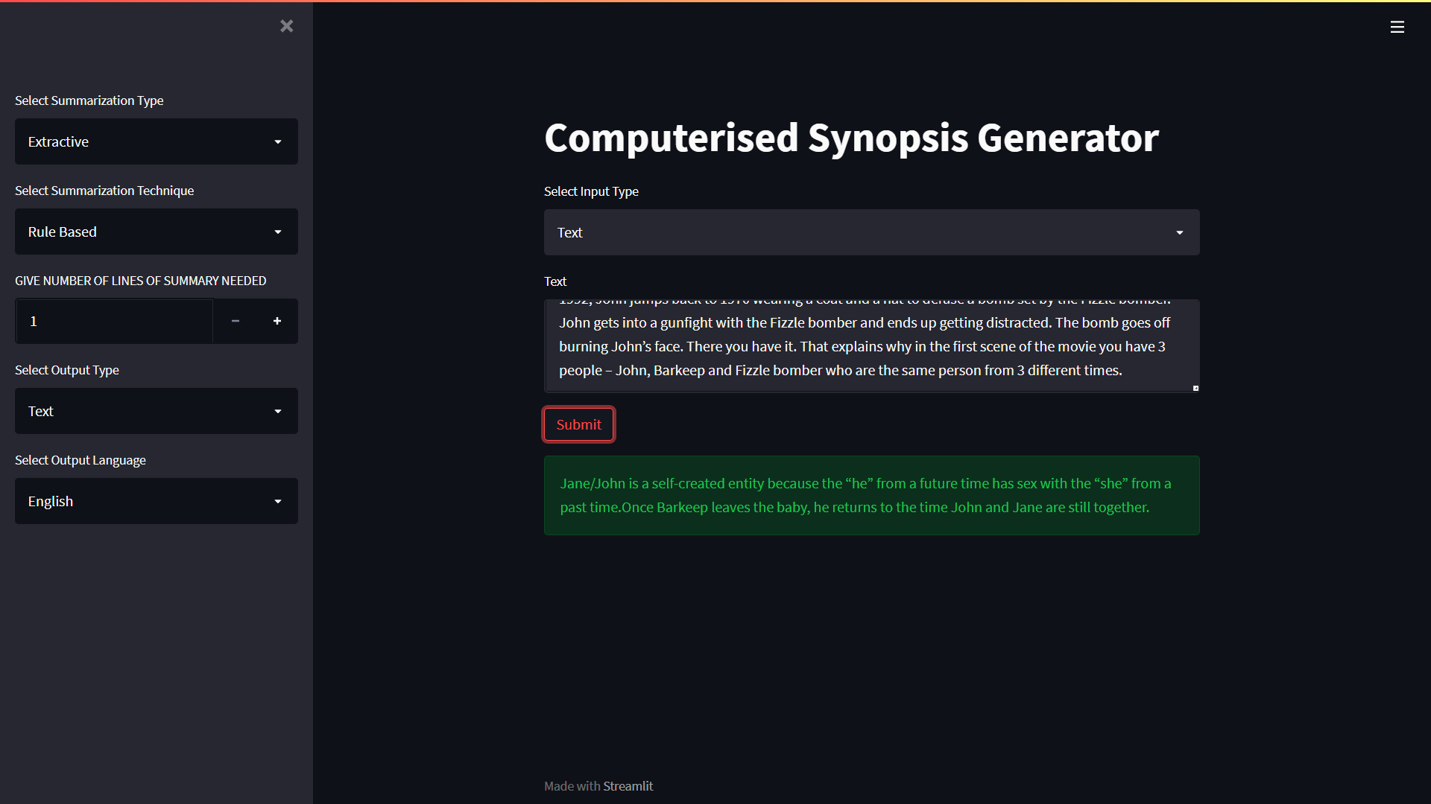
Extractive Using Rule Based

Slide 24
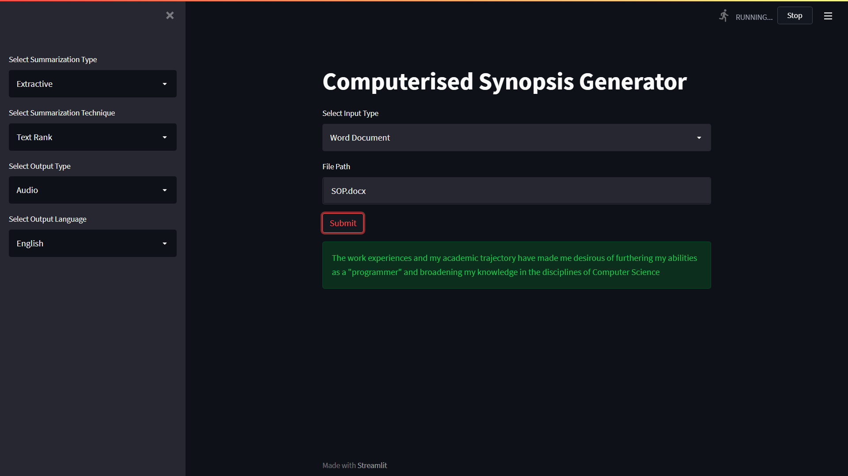
Extractive Using Text Rank

Slide 25
Results and Dicsussions
abs Pegasus head (back to future text) 1000 words 22s with audio English
abs Pegasus summary (back to future text) 1000 words 40s with audio English
Ext Gensim 0.2 (speech.wav) 1min25secs 35s with audio English
Ext Rule Based (assignment.pdf) 1074 words 10s with audio English
Ext Text Rank (SOP.docx) 1164 words 10s with audio Hindi
Ext Pegasus (health.wav) 7mins 4mins30 secs to convert to text 30s summary no audio
Ext Pegasus (health.wav) 7mins 4mins30 secs to convert to text 30s 10s summary 10s Marathi audio
Ext Gensim (mkbhd.wav) 18mins 10mins30secs to convert to text 45secs summary 10s English Audio

Slide 26
Comparison of models 5940 words
Models | Method | Output(word count)
Pegasus (xsum) | Abstractive | 96
Pegasus(Large) | Extractive | 711
Pegasus(reddit) | Abstractive | 174
Gensim | Extractive | Ratio : 0.2=1545 0.3=2298
Rule Based | Extractive | Depends on sentences
Text Rank | Extractive | Input Top-3= 490

Slide 27
SWOT ANALYSIS
STRENGTHS
Speech Summarizer and user has the ability to select the summarization method and its length.
WEAKNESSES
In abstractive methods, the accuracy may vary.
S
W
No current product in the market with corporate implementation.
OPPORTUNITIES
Improve accuracy. THREATS
O
T

Slide 28
Future Scope
For future works, the current project works only and only for English language but in future we can expand this in such a way that it can support not only various languages but also inter language summarization.
Apart from the single document summarization, we can enhance this project to summarize multiple documents at the same time.
The time complexity of converting speech to text can be modified to achieve a faster and more accurate level.
The input type for speech to text currently only accepts wav files. This drawback needs to be amended such that it can support various file types.

Slide 29
References
U. Hahn and I. Mani, “of Automatic Researchers are investigating summarization tools and methods that,” in IEEE Computer 33.11, no. November, pp. 29–36, IEEE, 2000.
K. Sparck Jones, “Automatic summarising: The state of the art,” Information Processing Management, vol. 43, pp. 1449–1481, Nov 2007.
J.N.Madhuri, Ganesh Kumar “Extractive Text Summarization Using Sentence Ranking”, Institute of Electrical and Electronics Engineers (IEEE), 2019.
Aakanksha Sharaff, Amit Siddharth Khaire, Dimple Sharma,” Analyzing fuzzy based approach for extractive text summarization”,International Conference on Intelligent Computing and Control Systems (ICICCS 2019),
Siya Sadashiv Naik, Manisha Naik Gaonkar,” Extractive Text Summarization by Feature based sentence extraction using rule based”, IEEE International Conference On Recent Trends in Electronics Information Communication Technology (RTEICT),2017

Slide 30
References
Kaiz Merchant, Yash Pande,” NLP Based Latent Semantic Analysis for Legal Text Summarization”, IEEE,2018.
Parth Rajesh Dedhia, Hardik Pradeep Pachgade, Aditya Pradip Malani, Nataasha Raul, Meghana Naik, “Study on Abstractive Text Summarization Techniques”,International Conference on Emerging) Trends in Information Technology and Engineering, 2020.
R. A. Garcıa-Hernandez and Y. Ledeneva, “Word sequence models for single text summarization,” in Proceedings of the 2nd International Conferences on Advances in Computer-Human Interactions, ACHI 2009, pp. 44–48, IEEE, 2009.
Mofiz Mojib Haider, Md. Arman Hossin,” Automatic Text Summarization Using Gensim Word2Vec and K-Means Clustering Algorithm”, IEEE, 2020.
D. Das and A. Martins, “A survey on automatic text summarization. literature survey for language and statistics,” II Course at CMU, 2007.

Slide 31
References
Partha Mukherjee, Soumen Santra, Subhajit Bhowmick,”Development of GUI for Text-to-Speech Recognition using Natural Language Processing”, IEEE, 2018.
Daksha Singhal, Kavya Khatter, Tejaswini A , Jayashree R,” Abstractive Summarization of Meeting Conversations”, IEEE, 2020.
Narendra Andhale, L.A. Bewoor, “An Overview of Text Summarization Techniques”, IEEE, 2016.
Meena S M, Ramkumar M P, “Text Summarization Using Text Frequency Ranking Sentence Prediction”, ICCCSP, 2000.
M Indu, Kavitha K V, “Review on text summarization evaluation methods”, IEEE, 2020.
Mahsa Afsharizadeh, Hossein Ebrahimpour-Komleh, Ayoub Bagheri “Queryoriented Text Summarization using Sentence Extraction Technique”, ICWR, 2018.

Slide 32
THANKS!

